Slide 1

Bill Martin Jr.
Nominations
2017-2018

Slide 2

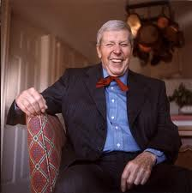
Who is Bill Martin Jr?
Author and Illustrator
Born in 1916
Grew up in Hiawatha, Kansas
(Northeast corner of Kansas)
Struggled learning to read as a child
First career was a teacher
Wrote more than 300 children’s books
Died in 1996 at the age of 80 of natural causes

Slide 3


What is the Bill Martin Jr. Award?
As a tribute to Bill Martin, Jr., the Kansas Reading Association established a picture book award in his honor in 1996. One picture book is honored each year with this distinguished title, the winner of the
Bill Martin Jr. Picture Book Award.

Slide 4

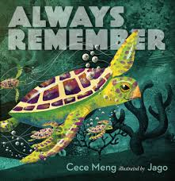
Always Remember
Written by Cece Meng & Illustrated by Jago
After old turtle swims his last swim and breathes his last breath, his friends lovingly remember how he impacted each and every one of them. The sea animals realize that Old Turtle is not truly gone, because his memory and legacy will last forever.

Slide 5
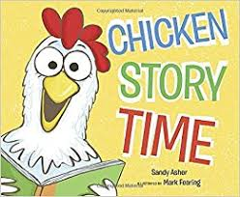
Chicken Story Time
Written by Sandy Asher
Illustrated by Mark Fearing
Why did the chicken cross the road? To get to the story time at the library, of course! The children like the chicken, the chicken likes the children, and everyone loves story time. So it’s no surprise that more children (and more chickens!) get in on the fun.

Slide 6

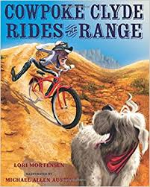
Cowpoke Clyde Rides the Range
Written by Lori Mortensen
Illustrated by Michael Allen Austin
Cowpoke Clyde is plumb confused. An ad in his favorite catalog says he oughta buy a bike. He orders one, and when it comes, he mounts up and sets right off, wibble-wobblin’ down the road.

Slide 7

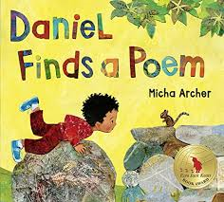
Daniel Finds a Poem
Written & Illustrated by Micha Archer
What is poetry?
Is it glistening morning dew?
Is it crisp leaves crunching?
Could it be a cool pond,
sun-warmed sand,
or moonlight on the grass?
Maybe poetry is all of these
things, as it is something special
for everyone –
you just have to take the time to really look and listen.

Slide 8

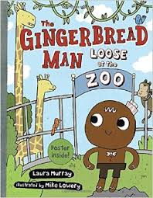
The Gingerbread Man Loose at the Zoo
Written by Laura Murray
Illustrated by Mike Lowery
Is there anything more fun than a class trip to the zoo? The Gingerbread Man and his classmates don’t think so, and they get to solve the riddles on a WILD scavenger hunt. They meet giraffes, monkeys, and even a fox (especially scary for a Gingerbread Man!).

Slide 9
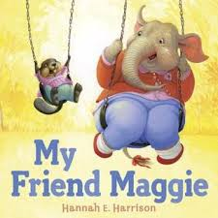
My Friend Maggie
Written & Illustrated by Hannah E. Harrison
Paula and Maggie have been friends forever. Paula thinks Maggie is the best – until mean girl Veronica says otherwise. Suddenly, Paula starts to notice that Maggie is big and clumsy, and her clothes are sort of snuggish. Luckily, when Veronica turns on Paula, Maggie’s true colors shine through.

Slide 10

Plants Can’t Sit Still
Written by Rebecca Hirsch
Illustrated by Mia Posada
Do plants really move?
Plants might not pick up their roots and walk away, but they definitely don’t sit still! Whether it’s a sunflower, a Venus flytrap, or an exotic plant like an exploding cucumber, this fascinating picture book shows just how excitingly active plants really are.

Slide 11
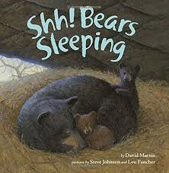
Shh! Bears Sleeping
Written by David Martin
Illustrated by Lou Fancher
Illustrations and simple, rhyming text follow a family of bears from one spring to the next. Includes facts about bears.

Slide 12
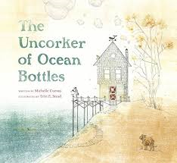
The Uncorker of Ocean Bottles
Written by Michelle Cuevas
Illustrated by Erin E. Stead
The Uncorker of Ocean Bottles, who lives alone atop a hill, has a job of utmost importance. It is his task to open any bottles found at sea and make sure that the messages are delivered. He loves his job, though he has always wished that, someday, one of the letters would be addressed to him.

Slide 13

The Water Princess
Written by Susan Verde
Illustrated by Peter H. Reynolds
With its wide sky and warm earth, Princess Gie Gie’s kingdom is a beautiful land. But clean drinking water is scarce in her small African village. And try as she might, Gie Gie cannot bring the water closer; she cannot make it run clearer. She rises before the sun to make the long journey to the well. Instead of a crown, she wears a heavy pot on her head to collect the water.

Slide 14
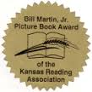
*** BMJ Award Trivia ***
Do you remember
last year’s
Bill Martin Jr.
award winner?

Slide 15
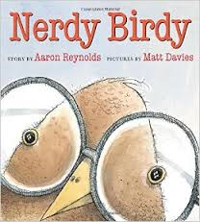
2016 Winner – Nerdy Birdy
Written by Aaron Reynolds
Illustrated by Matt Davies
Nerdy Birdy likes reading, video games and reading about video games. The cool birdies like hunting, showing off and devouring worms. They don’t like nerdy birdies. Dejected and friendless, Nerdy Birdy soon discovers that there are far more nerdy birdies than cool birdies in the sky.

Slide 16

To Learn More Visit…
htthttp://www.billmartinjr.com/
http://www.kansasread.org/Bill_Martin_Jr_Award.htmb

